Slide 1




Department of Robotics & Automation
ವಿಶ್ವೇಶ್ವರಯ್ಯ ತಾಂತ್ರಿಕ ವಿಶ್ವವಿದ್ಯಾಲಯ, ಬೆಳಗಾವಿ
VISVESVARAYA TECHNOLOGICAL UNIVERSITY - BELAGAVI
Major Project Presentation On
Development of an Autonomous Serving Robot For Efficient
Food Delivering in Restaurants.
Project Guide:
Ms. Gayathri A
Asst.Professor
Robotics & Automation
Project Associates:
DV Darshan (4GM22RA004)
Samarth N Vernekar (4GM22RA034)
TR Thirumala Venu (4GM22RA042)
Madhu UK (4GM23RA403)
1

Slide 2
Contents
Abstract
Introduction
Literature Survey
Problem Statement
Objectives of the Work
Methodology
2
Dept of RA, GMIT, Davangere

Slide 3
Contents (continued)
Results & Discussion
Advantages
Limitations
Applications
Future Work
Conclusion
References
3
Dept of RA, GMIT, Davangere

Slide 4
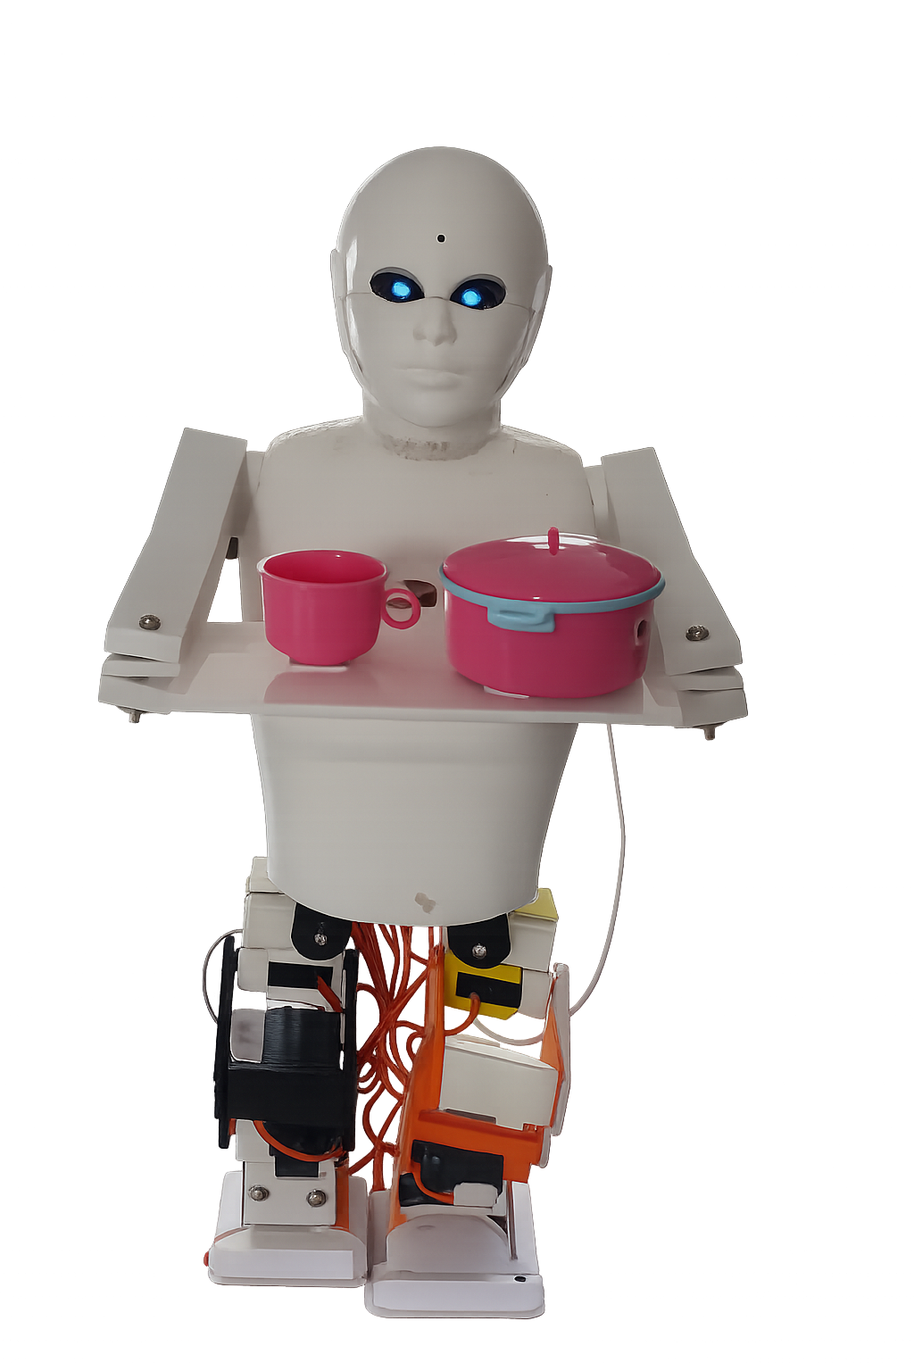
Abstract
Autonomous service robots are increasingly used in restaurants to improve efficiency.
This project presents the development of a compact humanoid serving robot designed for autonomous food delivery and customer interaction.
The robot operates in Serving Mode and Q/A Mode, ensuring smooth movement and reliable operation.
Using IMU-based balance control and OLED for Eye expression.
A web-based dashboard enables real-time monitoring, control, and mode switching, making the system suitable for modern hospitality environments.
4
Dept of RA , GMIT, Davangere

Slide 5
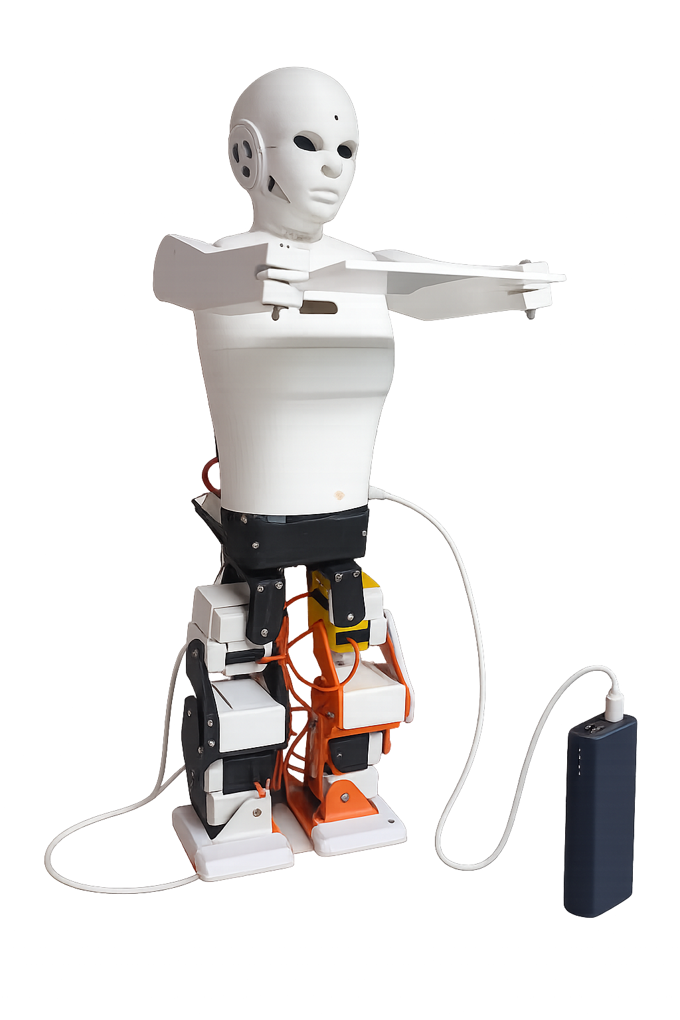
Introduction
Manual food delivery in restaurants leads to staff fatigue, delays, and inconsistent service during peak hours.
Automation in hospitality helps reduce workload and improve service quality.
Service robots can perform repetitive delivery tasks while maintaining hygiene and consistency.
This project focuses on developing a humanoid robot with smooth movement and user-friendly interaction for indoor restaurant environments.
5
Dept of RA , GMIT, Davangere

Slide 6
Literature Survey
Si. No. | Author & Ref. | Core Focus | Key Contributions | Research Gap Identified | Relevance to our Project
1. | Wan & Choi (2021) | Service robots in hospitality industry | Highlighted benefits of service robots in restaurants such as efficiency, hygiene, and reduced staff workload | Lack of affordable and compact humanoid solutions for small restaurants | Justifies need for a compact autonomous serving robot
2. | Beltran et al. (2019) | Low-cost indoor navigation for food delivery robots | Demonstrated time-based indoor navigation suitable for restaurant environments | Limited interaction features and rigid navigation paths | Supports use of simple indoor navigation for food delivery
3. | Qi et al. (2021) | Humanoid service robot design | Introduced humanoid design for improved interaction and acceptance | High system complexity and cost | Motivates simplified humanoid design with essential features
6
Dept of RA , GMIT, Davangere

Slide 7
Literature Survey (continued)
Si. No. | Author & Ref. | Core Focus | Key Contributions | Research Gap Identified | Relevance to our Project
4. | Li et al. (2025) | Expressive robot display faces | Showed that expressive OLED eyes improve user trust and engagement | Focused mainly on interaction, not delivery tasks | Supports use of expressive OLED eyes in our serving robot
5. | ACM Digital Library (2024) | ESP32-based food serving robot with web dashboard | Demonstrated dual-mode operation with dashboard-based monitoring | Limited focus on smooth motion and stability | Validates ESP32 and dashboard-based control in our projec
7
Dept of RA , GMIT, Davangere

Slide 8
Problem Statement
Manual food delivery in restaurants leads to staff fatigue and service delays, especially during peak hours.
Existing serving methods lack consistency, hygiene, and efficiency in crowded indoor environments.
Available service robots are often expensive, complex, or unsuitable for small and medium restaurants.
There is a need for a compact, smooth-moving, and reliable autonomous serving robot with basic customer interaction.
8
Dept of RA , GMIT, Davangere

Slide 9
Objectives of the Work
To design a compact humanoid robot for autonomous food delivery in restaurants.
To achieve smooth and stable movement using IMU-based balance control.
To implement dual operating modes for food serving and customer interaction.
To enable monitoring and control through a web-based dashboard.
9
Dept of RA , GMIT, Davangere

Slide 10
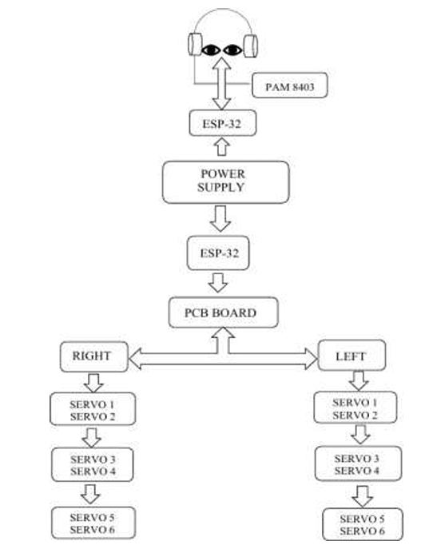
Methodology
A Li-ion battery with power management circuit supplies regulated power to all robot modules.
An ESP32 MCU acts as the main controller, coordinating sensing, motion, and communication.
IMU feedback is used to maintain balance and ensure smooth humanoid movement during operation.
The robot operates in dual modes (Serving Mode and Q/A Mode), controlled and monitored through a web dashboard, with audio feedback provided via a speaker.
10
Dept of RA , GMIT, Davangere

Slide 11
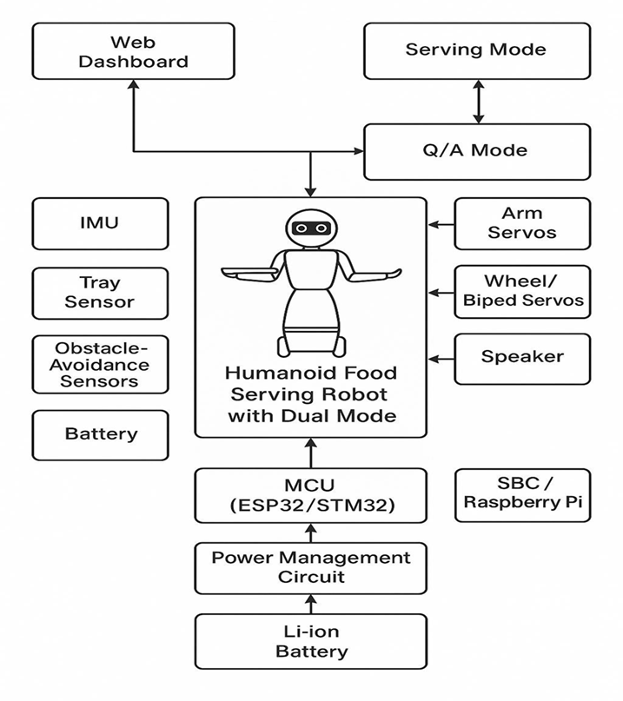
Block Diagram
11
Dept of RA , GMIT, Davangere

Slide 12
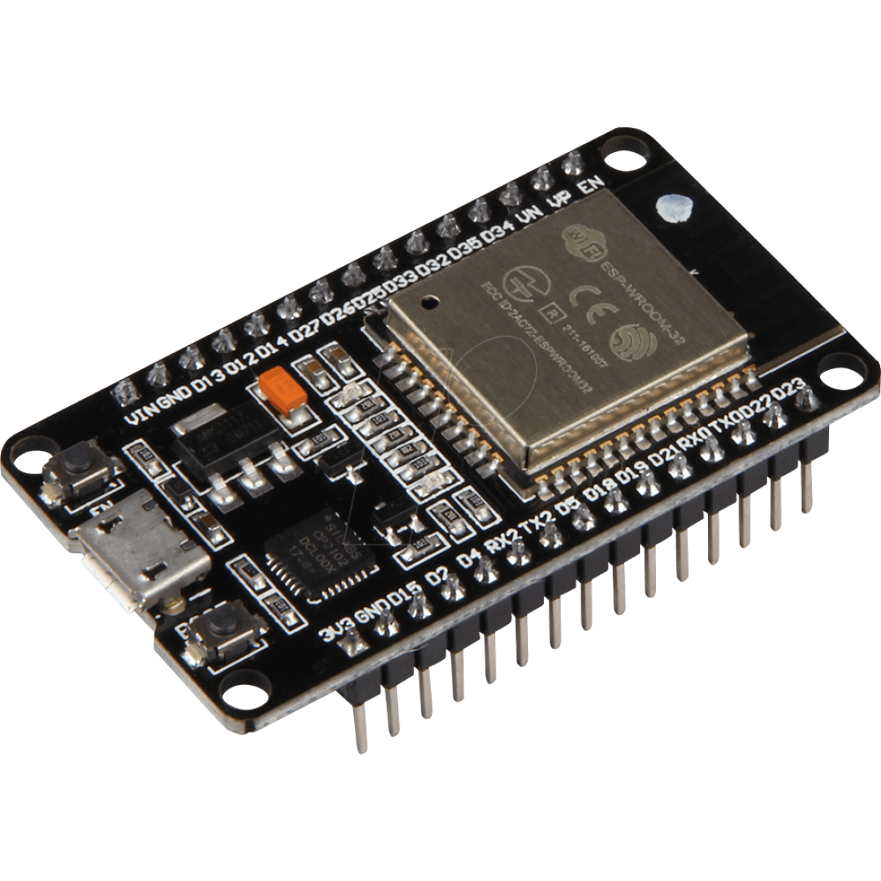
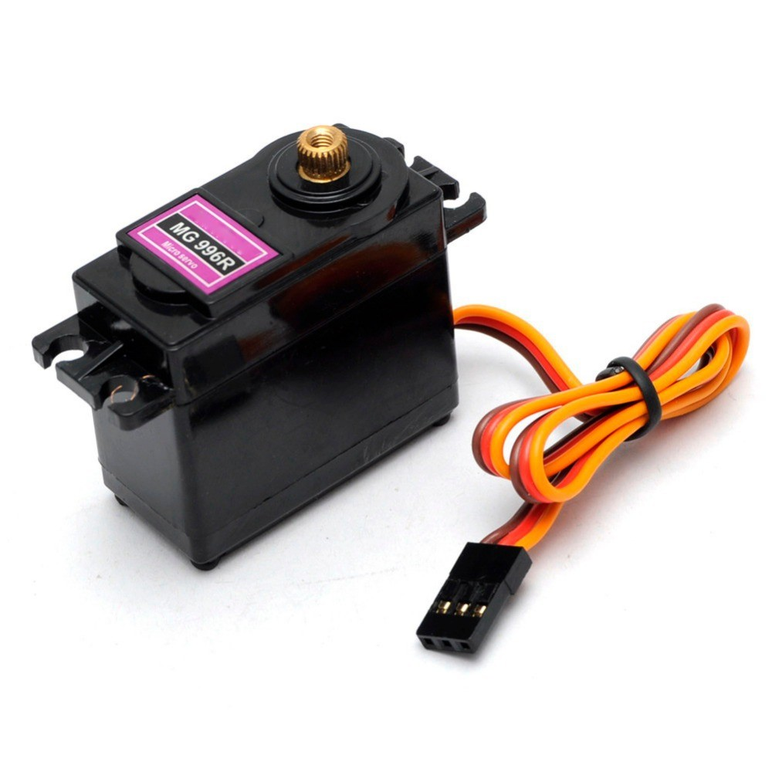
Components Used
1. Servo Motor
2. Arduino Uno
Specifications:
• Torque & Type: 10 kg-cm waterproof digital servo(PWM control)
• Voltage & Speed: 4.8–7.2 V operating range
• Build: Metal gears, 40×20.5×40.5 mm size
Specifications:
• Dual-core processor • Operating voltage: 5V • Built-in Wi-Fi and Bluetooth • Multiple GPIO, PWM, ADC interfaces

Slide 13
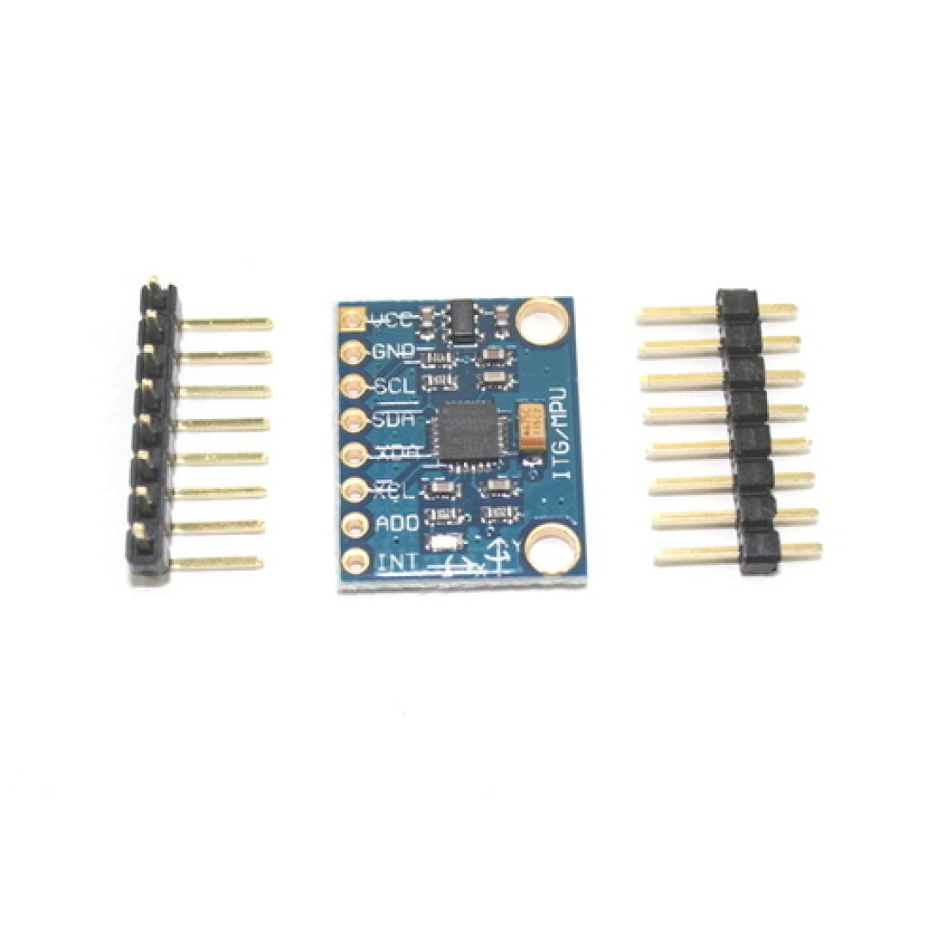
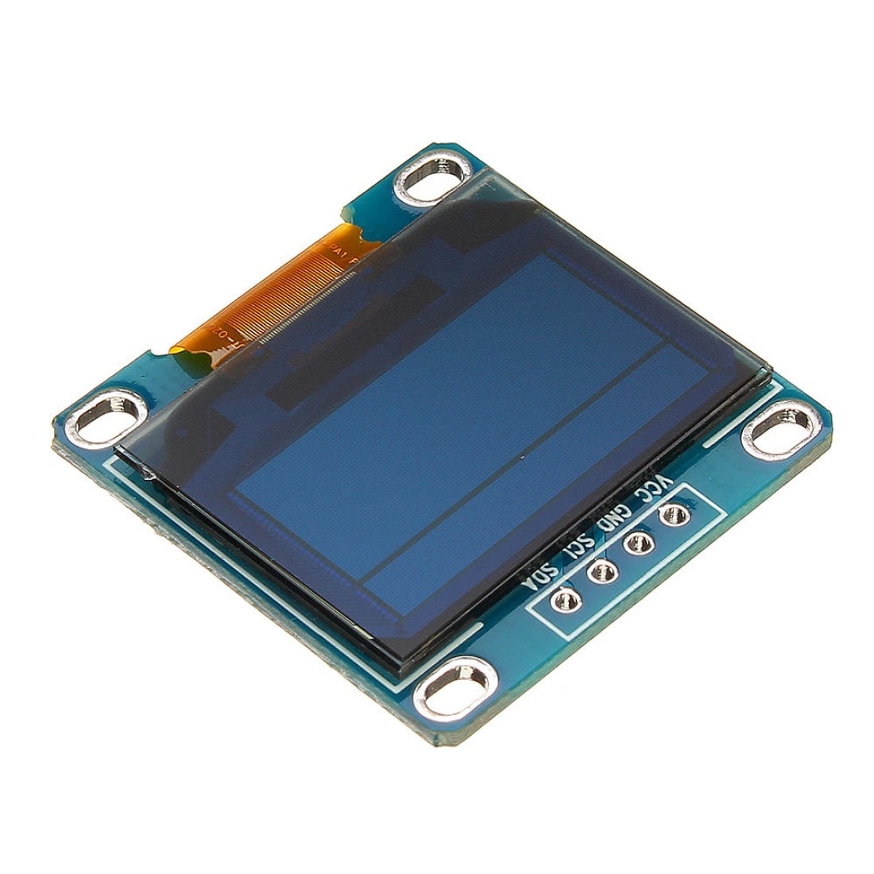
Components Used (continued)
3. MPU - 6050 (IMU)
4. OLED Display
Specifications:
• Measures acceleration and angular velocity • Operating voltage: 3.3–5 V • Provides real-time orientation and balance data • High sampling rate for smooth motion control
Specifications:
• Size: 0.96-inch OLED • Resolution: 128 × 64 pixels • Interface: I²C • Low power consumption and high contrast

Slide 14
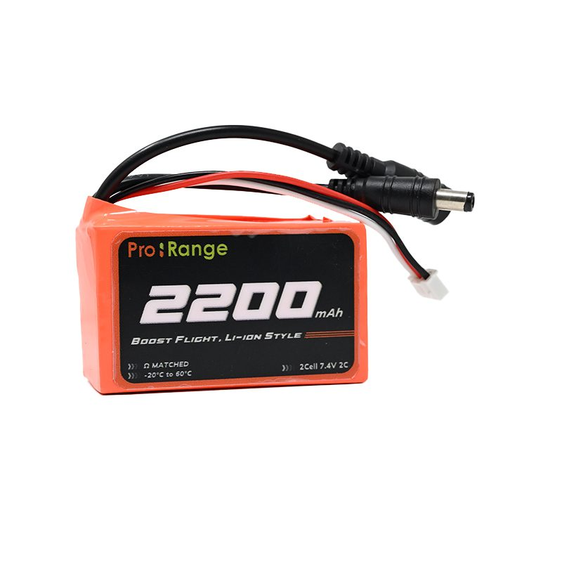
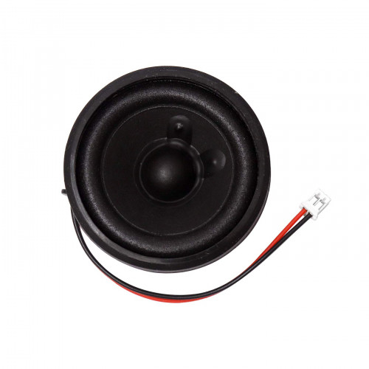
Components Used (continued)
5. Li-Ion Battery
6. 3w Mini Speaker
Specifications:
• Nominal Voltage: 7.4 V • Capacity: 2200 mAh • Maximum Voltage (Fully Charged): 8.4 V • Connector Type: XT60 • Lightweight and high discharge capability
Specifications:
• Output power: 3 W • Operating voltage: 5 V • Used for voice output and alerts • Compact and lightweight

Slide 15
Results & Discussion
The developed humanoid serving robot successfully demonstrated smooth and stable movement during indoor testing. IMU-based balance control helped maintain stability while carrying food trays, reducing sudden jerks and improving motion reliability. The dual-mode operation enabled effective food serving and basic customer interaction through the web dashboard. The system responded well to dashboard commands with minimal delay, confirming reliable communication and control. Overall, the results validate that a compact, ESP32-based humanoid robot can perform efficient food delivery in restaurant environments.
15
Dept of RA , GMIT, Davangere

Slide 16
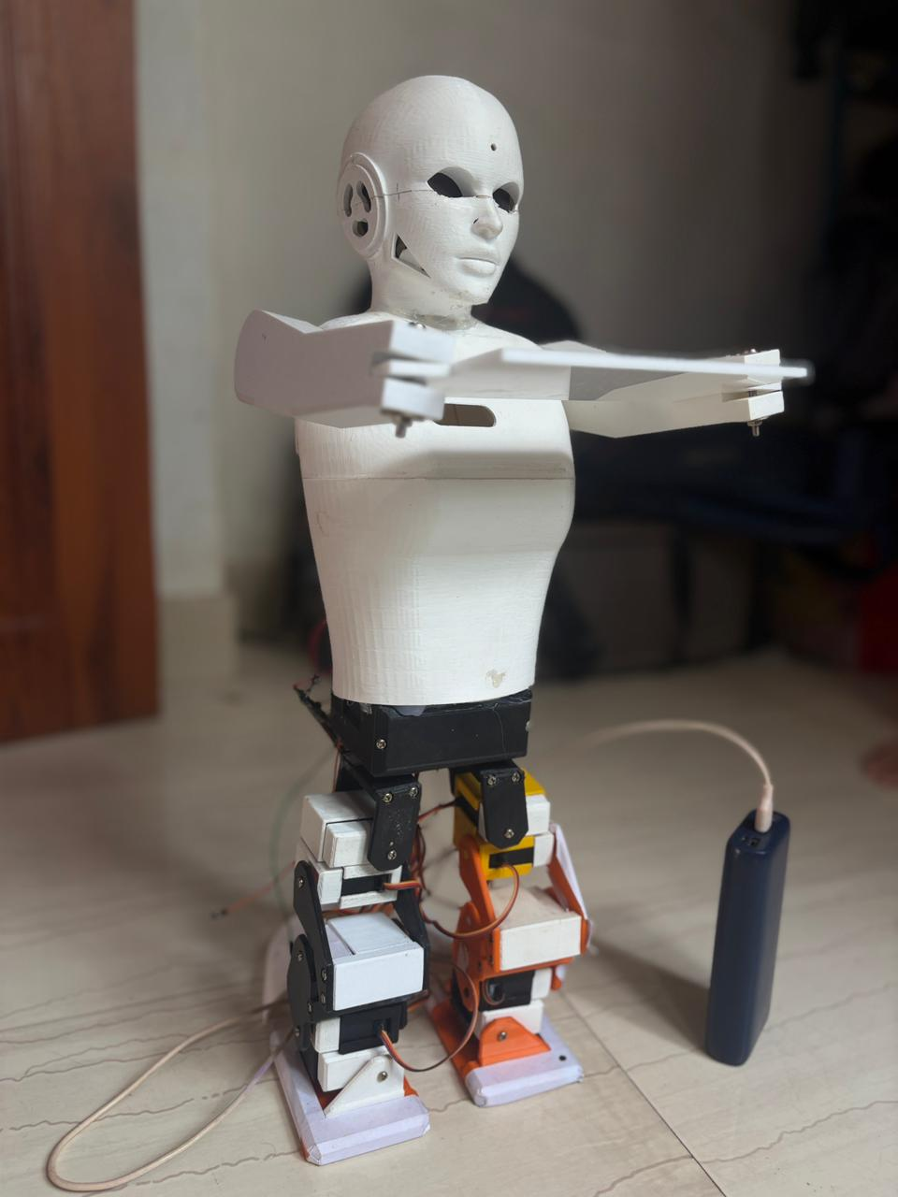

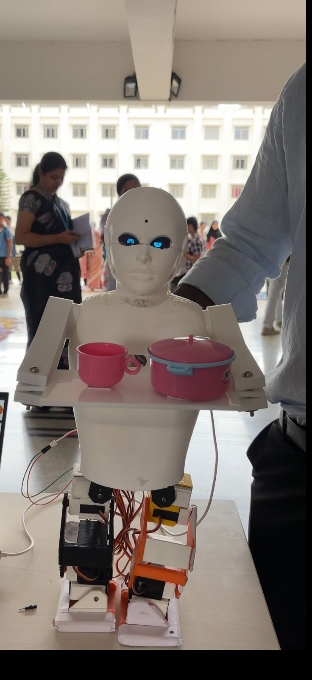
Output
16

Slide 17

Output (voice)
1.Introduction
2.reply
17

Slide 18
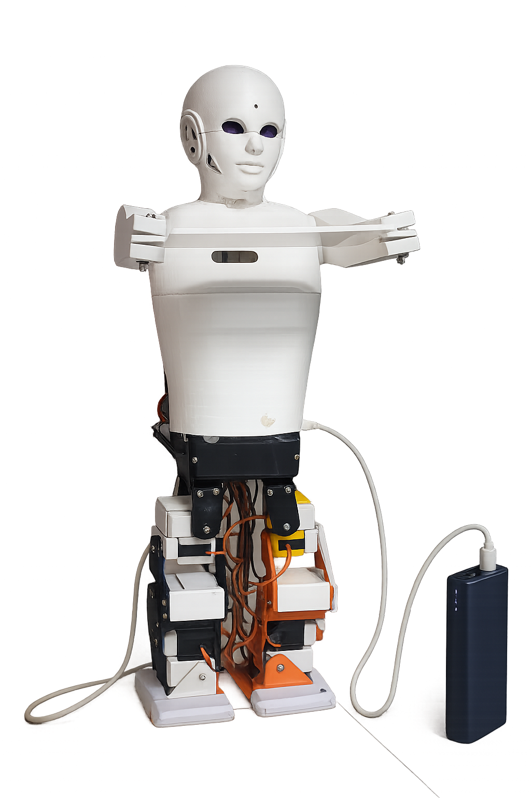
Advantages
Reduces workload and fatigue of restaurant staff.
Smooth and stable movement improves service reliability.
Hygienic and contactless food delivery system.
Easy monitoring and control using web dashboard.
18
Dept of RA , GMIT, Davangere

Slide 19
Limitations
Designed mainly for indoor environments.
Limited load-carrying capacity.
Dependent on stable Wi-Fi connectivity.
Navigation limited to predefined paths.
19
Dept of RA , GMIT, Davangere

Slide 20
Applications
Restaurants and cafés for automated food delivery
Hotels for room service and customer assistance
Hospitals for contactless item delivery
Educational institutions for research and demonstrations
20
Dept of RA , GMIT, Davangere

Slide 21
Future Work
Implement adaptive navigation algorithms to handle dynamic restaurant layouts and moving people.
Integrate advanced voice recognition and natural language processing for improved customer interaction and order handling.
Enhance battery management and power optimization to support longer operational hours.
Improve mechanical design to increase load capacity and movement efficiency.
Incorporate machine learning-based behavior adaptation for smarter and more autonomous service operation.
21
Dept of RA , GMIT, Davangere

Slide 22
Conclusion
A compact humanoid autonomous serving robot was successfully developed.
The system achieved smooth and stable movement using IMU-based control and performed reliable food delivery operations.
Dual-mode functionality and dashboard integration enhanced usability and interaction.
The project demonstrates the potential of cost-effective humanoid robots in improving efficiency and hygiene in hospitality environments.
22

Slide 23
References
[1] Wan, L. C., & Choi, Y. (2021).
The rise of service robots in the hospitality industry. Boston Hospitality Review. [2] Beltran, J., Colorado, J., Muro, J., & Parra, C. (2019).
Design of a low-cost indoor navigation system for food delivery robots in restaurants. Sensors, 19(22), 4910. DOI: 10.3390/s19224910
[3] Qi, X., Zhang, M., Zhang, Y., & Ying, J. (2021).
Service humanoid robotics: A novel interactive system based on bionic design. PeerJ Computer Science, 7, e674. Available at: https://peerj.com/articles/cs-674.pdf
[4] Li, J., Saunderson, S., & Nejat, G. (2025).
See what I mean? Expressiveness and clarity in robot display faces. arXiv preprint arXiv:2506.16643.DOI: 10.48550/arXiv.2506.16643
[5] ACM Digital Library (2024).
ESP32-based food serving robot with dual delivery/interaction modes and web dashboard control.DOI: 10.1145/3723178.3723256 [6] Ivanov, S., & Webster, C. (2020).
Applications and implications of service robots in hospitality. Cornell Hospitality Quarterly, 61(3), 247–265.DOI: 10.1177/1938965520923961
[7] Zhang, F., Li, J., Zhang, X., Duan, S., & Yang, S.-H. (2025).
Indoor fusion positioning based on IMU–Ultrasonic–UWB and factor graph optimization. arXiv preprint arXiv:2503.12726. DOI: 10.48550/arXiv.2503.12726
[8] Zhang, Y., Keramat, M., Botteghi, N., et al. (2023).
Distributed robotic systems in the edge-cloud continuum with ROS 2. Journal of Intelligent & Robotic Systems, 109, 34.DOI: 10.1007/s10846-022-01792-5
23

Slide 24
THANK
YOU
Dept of ME , GMIT, Davangere

